Slide 1

Introduction to RNA-seq
Dr Adam Cribbs

Slide 2
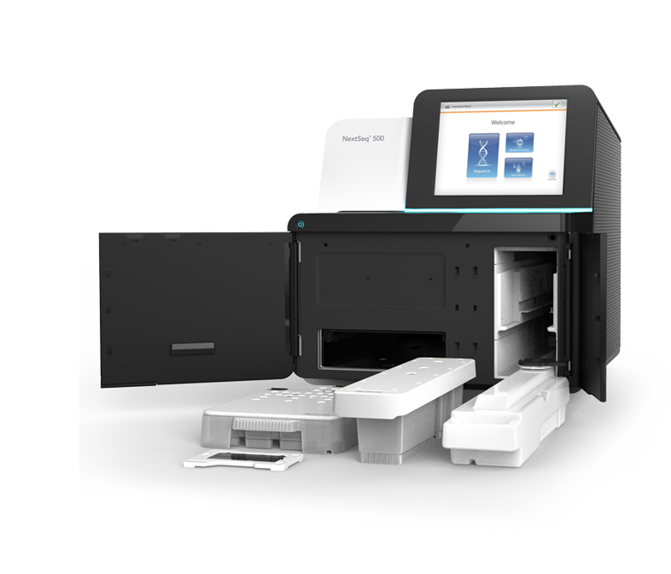
Agenda for this talk
01
Experimental design
02
Data formats and quality control
03
Challenges in data science
04
Software and pipelines

Slide 3
Good experimental design
Improves your chances of success
Saves a LOT of money
Obtains meaningful results
Easier when you come to publish your paper

Slide 4
Good experimental design
Rushing into an experiment leads to failure
80% chance of an NGS experiment working is determined before you even touch a pipette

Slide 5
Historical issues with NGS data
I have seen so much bad data and poorly designed experiments
Almost 70% of samples do not have biological replicates (Feng et al 2012)
ENCODE guidelines require only 2 biological replicates, this is controversial and too few

Slide 6
Specificity and power
Specificity: the proportion of results that are genuine, as opposed to false positives (type I error)
At FDR of 5%, 5 in every 100 results will be wrong
Power (sensitivity): the proportion of real results that are successfully identified in an experiment
With a 80% power, you will successfully identify 800 out of 1000 genuinely DE genes.
Power is often overlooked in experimental design

Slide 7
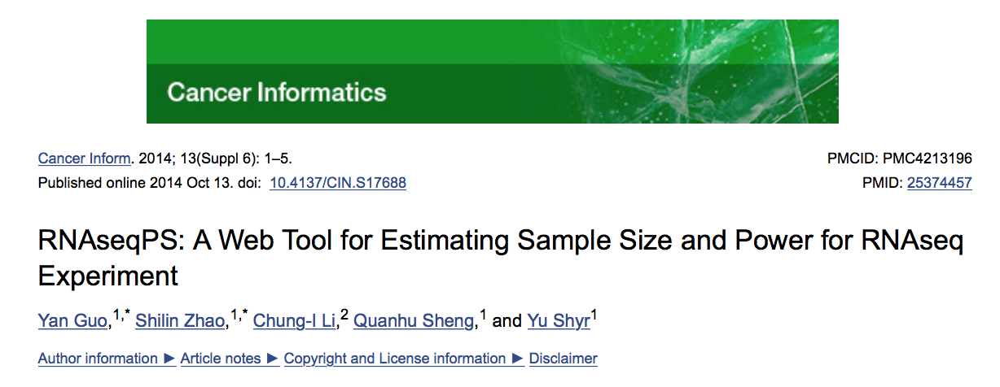
Power calculations
Power calculations are very important!
Pilot data is important for determining this
https://cqs.mc.vanderbilt.edu/shiny/RnaSeqSampleSize/

Slide 8
Adequately powered
Too many samples:
Wastes resources and time
Too few samples:
May lack power leading to unreliable results

Slide 9
How much power is enough power
Depends on the purpose of experiment
Just want to look at top expressed genes = not much
To get a comprehensive list of targets = a lot
Power expressed transcripts = a lot
Rare variants = a lot
Depends on the variability of the sample
Human samples = very variable
Mouse studies = less variable
Immunology = less variable
Cancer = very variable

Slide 10
Replicates

Slide 11
Cell line replicates
https://www.slideshare.net/jelena121/introduction-to-ngs-experimental-design?qid=7d0acf70-8728-47ee-ad2d-3f473dea0de8&v=&b=&from_search=1

Slide 12
How many replicates?
Minimum = 3 (cant compute s.d. on less than 3)
Lets you fit statistical distribution more accurately
My recommended minimum = 4/5
Allows for failure of a few
However, it depends on the experiment and other factors discussed before
Failure and improves specificity and sensitivity

Slide 13
Experimental bias
A biased experiment is no different from a useless one
Daniel Sarewitz
(Beware the creeping cracks of bias. Nature, 2012)

Slide 14
Avoiding bias
To avoid bias:
Correct selection of experimental conditions
Randomisation of experimental samples
Randomisation in which the order measurements are made
Blinded analysis of the data
Failure to blind can lead to false negative and false positive results

Slide 15
Avoiding confounding factors
Plate 1
Plate 2
Plate 3
Control
Treatment 1
Treatment 2
Control and treatments are confounded by Plate

Slide 16
Avoiding confounding factors
Control
Treatment 1
Treatment 2
Plate 1
Plate 2
Plate 3
Control and treatments are confounded by Plate location

Slide 17
Avoiding confounding factors
Control
Treatment 1
Treatment 2
Plate 1
Plate 2
Plate 3
Day 1
Day 2
Day 3
Control and treatments are confounded by Plate location and day of preperation

Slide 18
Avoiding confounding factors
Control
Treatment 1
Treatment 2
Plate 1
Plate 2
Plate 3
Day 1
Day 2
Day 3
Control and treatments are confounded by day of preperation

Slide 19
Avoiding confounding factors
Control
Treatment 1
Treatment 2
Plate 1
Plate 2
Plate 3
Getting better but still have potential confounding effects with plate location

Slide 20
Avoiding bias
Which sampled data is likely biased?
A
B

Slide 21
Avoiding confounding factors
Control
Treatment 1
Treatment 2
Plate 1
Plate 2
Plate 3
(you get the point that I couldn’t be bothered to draw all the colours)
Unlikely to be a confounded experiment

Slide 22
Source of bias
Sample collection
Sample preperation
Library prep
Sequencing

Slide 23
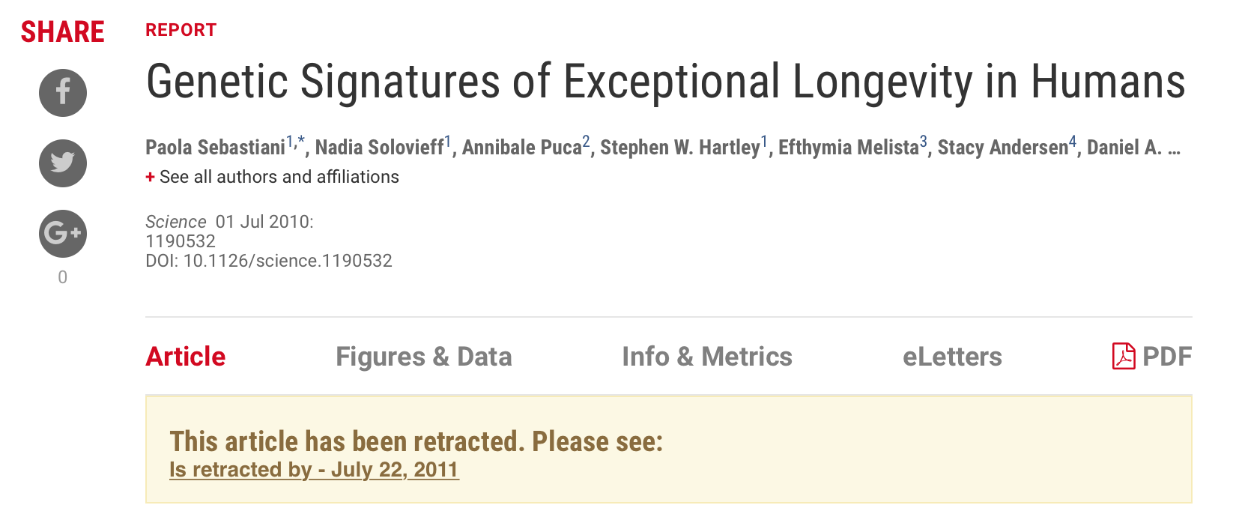
What happens when you don’t control for bias
Young and old individuals has SNP’s genotypes on different arrays

Slide 24
Pooling samples
Sometimes when you have very little material, pooling of samples is required
Better to pool the biological samples and not RNA or DNA – problems are easier to spot
No way to estimate variation between donors, unless you somehow label (barcode) your samples
Outliers can be a problem and difficult to resolve

Slide 25
NGS sequencing

Slide 26
Application of NGS sequencing
Whole genome sequencing
Genome re-sequencing
de novo genome sequencing
Metagenomics applications
Epigenetic profiling
Methylation sequencing
Nucleosome footprinting
Sequencing of
Genomic DNA
Targeted sequencing
PCR-amplified regions
Capture-enriched DNA
Genomic footprinting
ChIP sequencing
Sequencing of
DNA library
Transcriptome analysis
Novel RNA classes (lncRNAs)
Novel splice variants
RNA footprinting
Ribosomal footprinting
RNA-IP sequencing
Sequencing of
cDNA library
Transcriptome expression
mRNA
Small RNA

Slide 27

Bioinformatic challenges
Now I have my data what do I do????

Slide 28
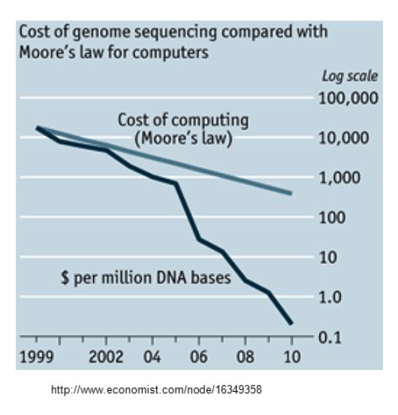
Bioinformatic challenges
2.7 billion to hundreds of £
NGS pushed the need for bioinformatics and big data analytics
Need for power!!

Slide 29
Need for computation
Need for computer power
VERY large files (10s of millions of lines)
Impossible to use familiar tools such as python
Impossible memory usage and execution time
Need for a large amount of compute power
Compute clusters
Parallel code and multi threading to speed up analysis
Need for faster software
Pipelines
Bioinformatics power!
Properly structured working

Slide 30
Data management issues
How to store data – very large raw data
Alternative data structures – e.g. binary storage (bam files)
Certain studies use different amounts of storage
RNA-seq per file 2Gb
WGS – 500 Gb files
Less of an issue now than it used to be 3-5 years ago – hardware improvements

Slide 31
Computational clusters
Multi-nodes (servers) with multi-cores
High performance storage (expensive)
In-line storage
Fast networks (50Gb Ethernet between nodes)
Located in a single data centre
Need skilled data-admin staff to monitor and fix issues

Slide 32
Cloud based analysis
Pros
Flexible
Pay for what you use
Don’t need to maintain a data centre
Cons
Transfer big data over internet is slow
You pay for bandwidth
Lower performance – disk IO
Privacy/data concerns
More expensive for long term projects

Slide 33
The future
NGS arrived in 2007/2008
No-one predicted NGS in 2001
How can we really predict the future?
Problems will always remain:
Software always lags behind hardware

Slide 34
Bioinformatics and computational biology
The term bioinformatician can mean many things
Usually little biology background but quantitative skills
Computational biologist is usually someone with a biology and quantitative background
There is definitely a massive skills shortage in both

Slide 35
How to learn computational skills
Introduction to Next-gen data analysis
EBI in Cambridge - https://www.ebi.ac.uk/training/online/course/functional-genomics-ii-common-technologies-and-data-analysis-methods/next-generation
OBDI program
3 month short term training for a particular skill
https://www.imm.ox.ac.uk/research/units-and-centres/mrc-wimm-centre-for-computational-biology/training
Undertake part of your PhD in a computational group

Slide 36
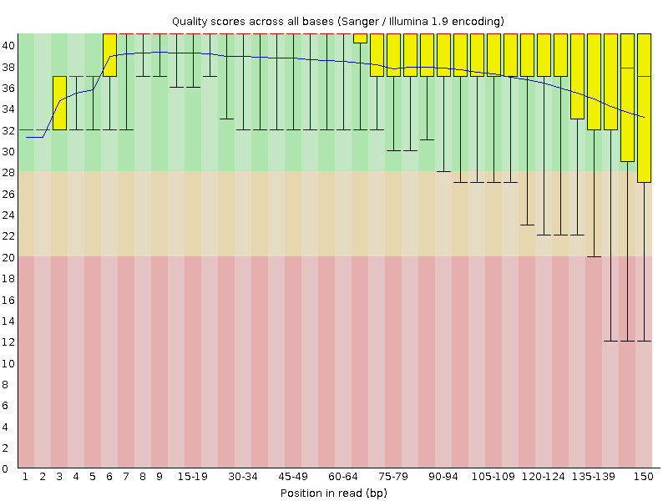
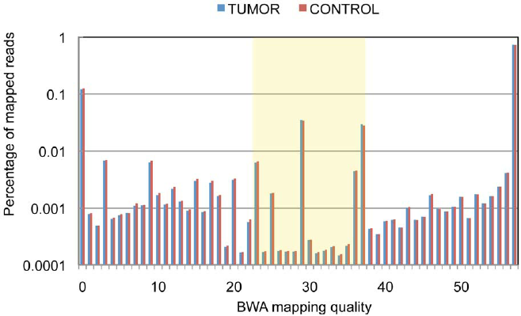
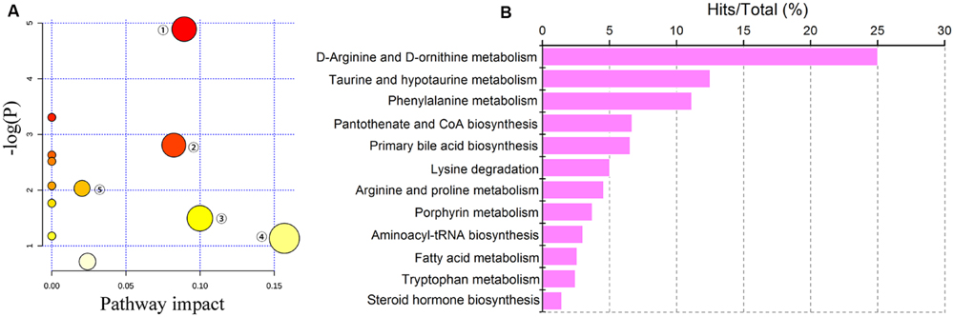
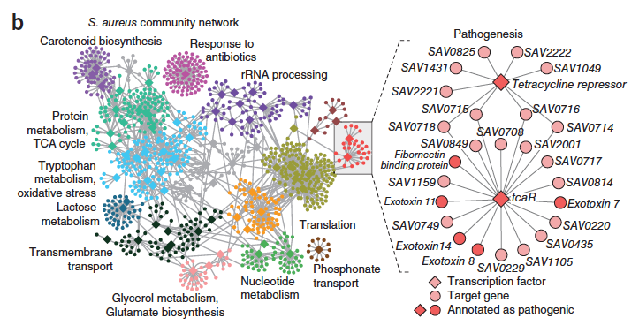
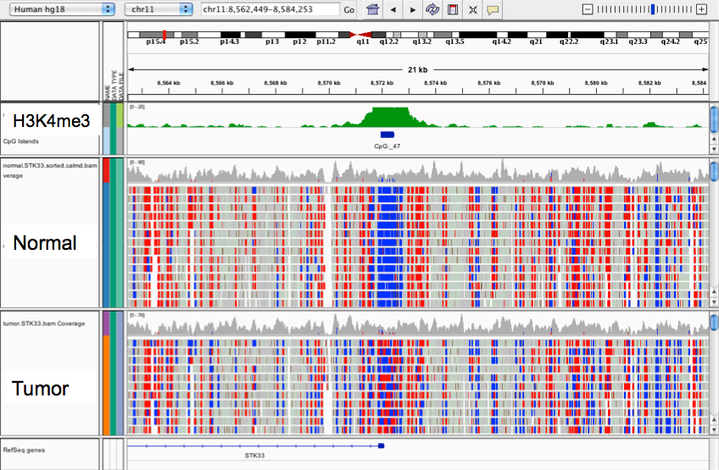
NGS data analysis
Raw reads from sequencer
Quality assessment of reads
Mapping
Pathway
analysis
Gene
networks
Data storage and visualisation

Slide 37
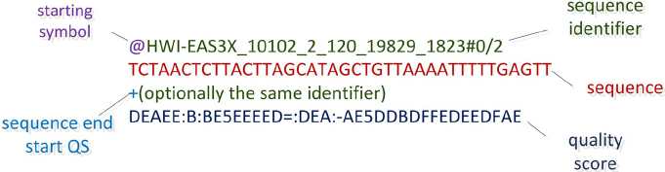
Quality control of reads
Sequencing output:
Reads + quality
Flat files – are very large – inefficient but it’s the standard
Question: is the quality of my sequencing data good?

Slide 38
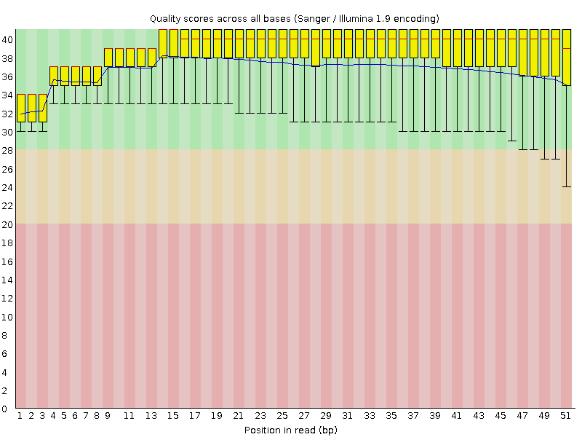
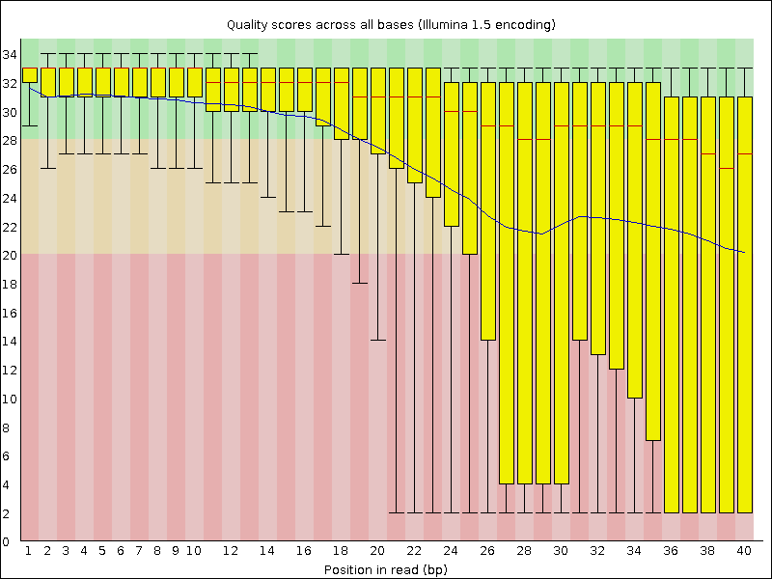
Quality control of reads
Fastqc – babraham institute
https://www.bioinformatics.babraham.ac.uk/projects/fastqc/

Slide 39
Tools to deal with read QC
Fastx-toolkit to optimize different datasets
Fastq-screen – check that all of your data is not contaminated
Trimming to improve quality
Trimmomatic
Cutadapt
There are many many more!
But beware of removing too many reads or trimming too much

Slide 40
Mapping reads to genome/transcriptome
Mapping data is very important to get correct
Many different mappers – make sure you use the latest software
Always treat your samples consistently

Slide 41
Mapping reads to genome/transcriptome
Main issues:
Number of mismatches
Number of multi-hits
Mates expected distance
Exon junction

Slide 42
NGS data formats

Slide 43
GTF file for mapping
File format for reference sequence

Slide 44
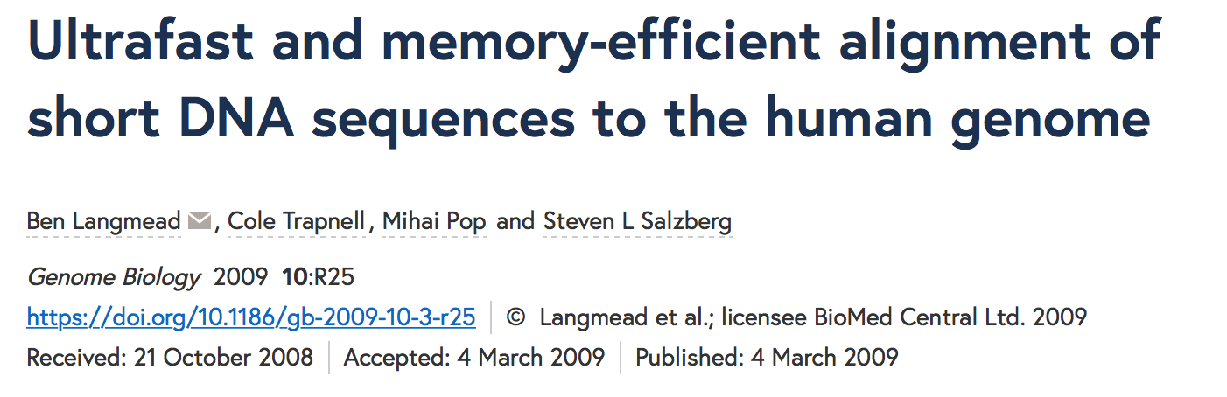
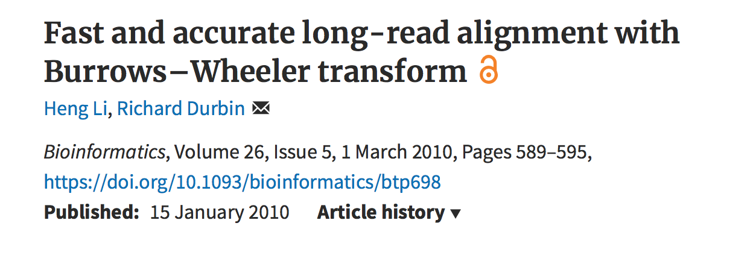
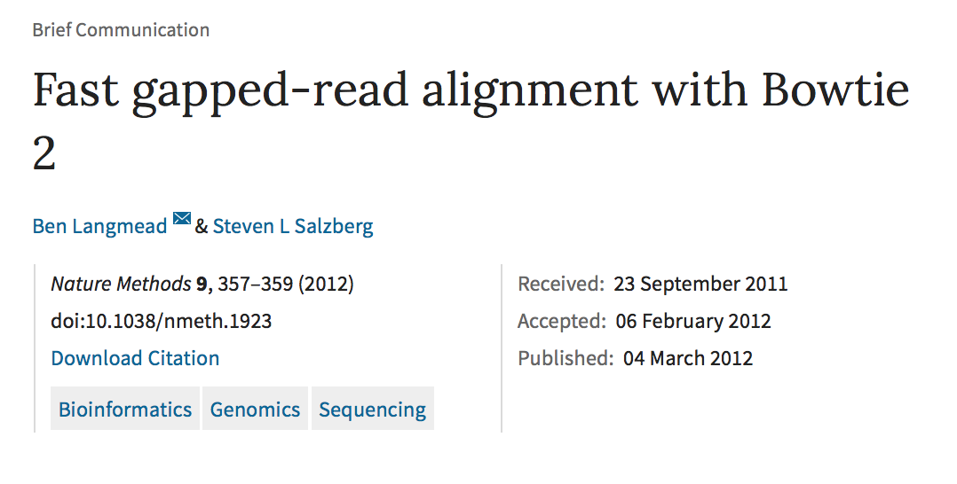
Mapping reads to genome
Which one to use???
Depends on application

Slide 45
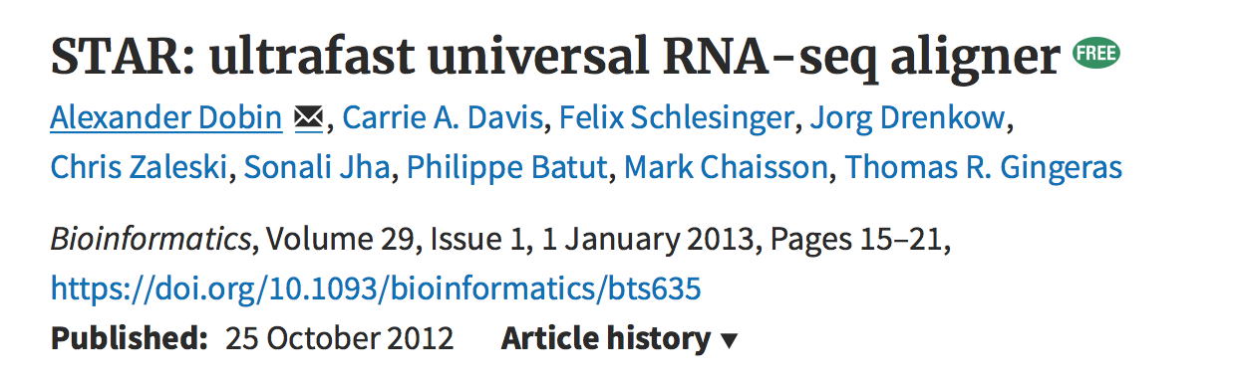
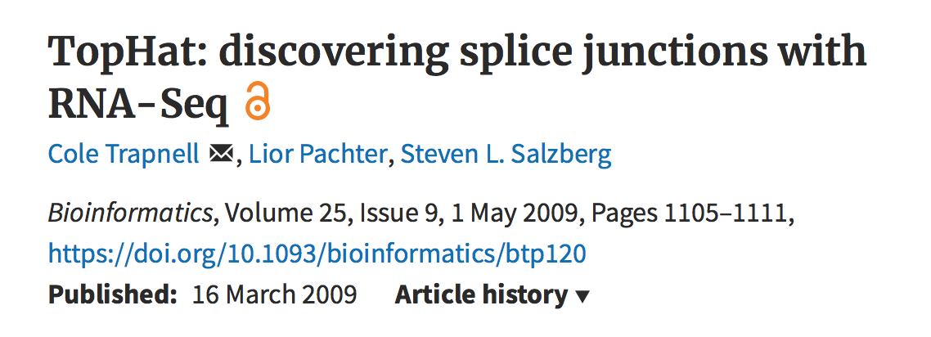
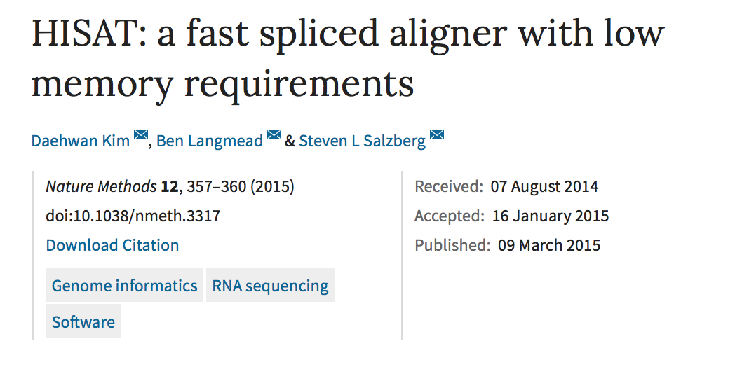
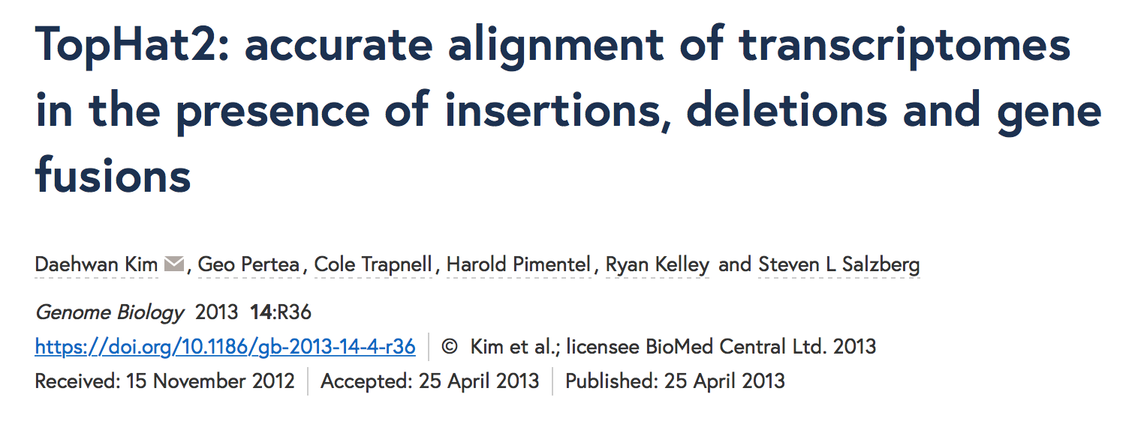
Mapping reads to transcriptome
Which one to use???
Depends on application
Don’t use tophat or hisat – use hisat2

Slide 46
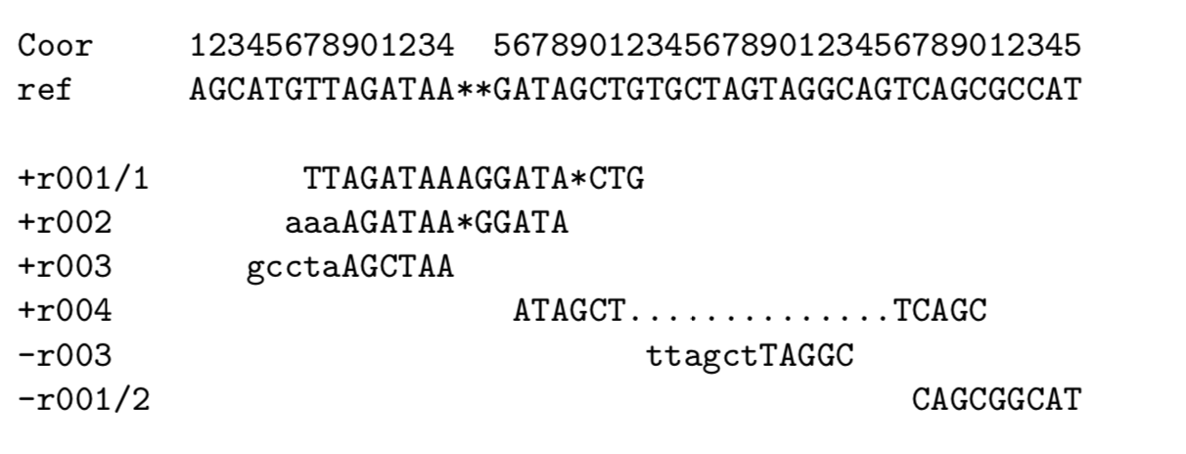
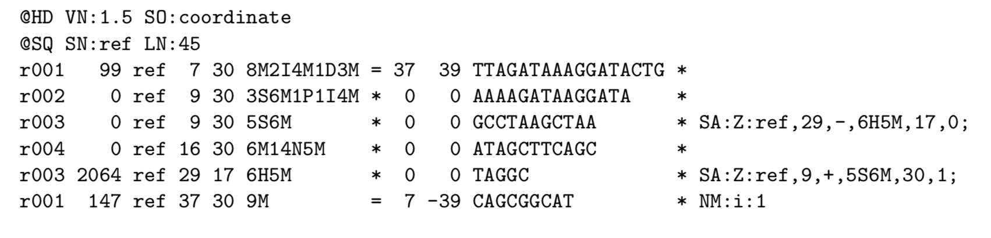
SAM/BAM format
Standard mapping output
Sequence alignment map (SAM)
Tab delimited
11 mandatory fields
1. Read name
10. Seq
2. Flag
4. Position
6. Cigar
8. Pos of mate
3. Reference
5. Quality
7. Ref name of mate
9. Template len

Slide 47
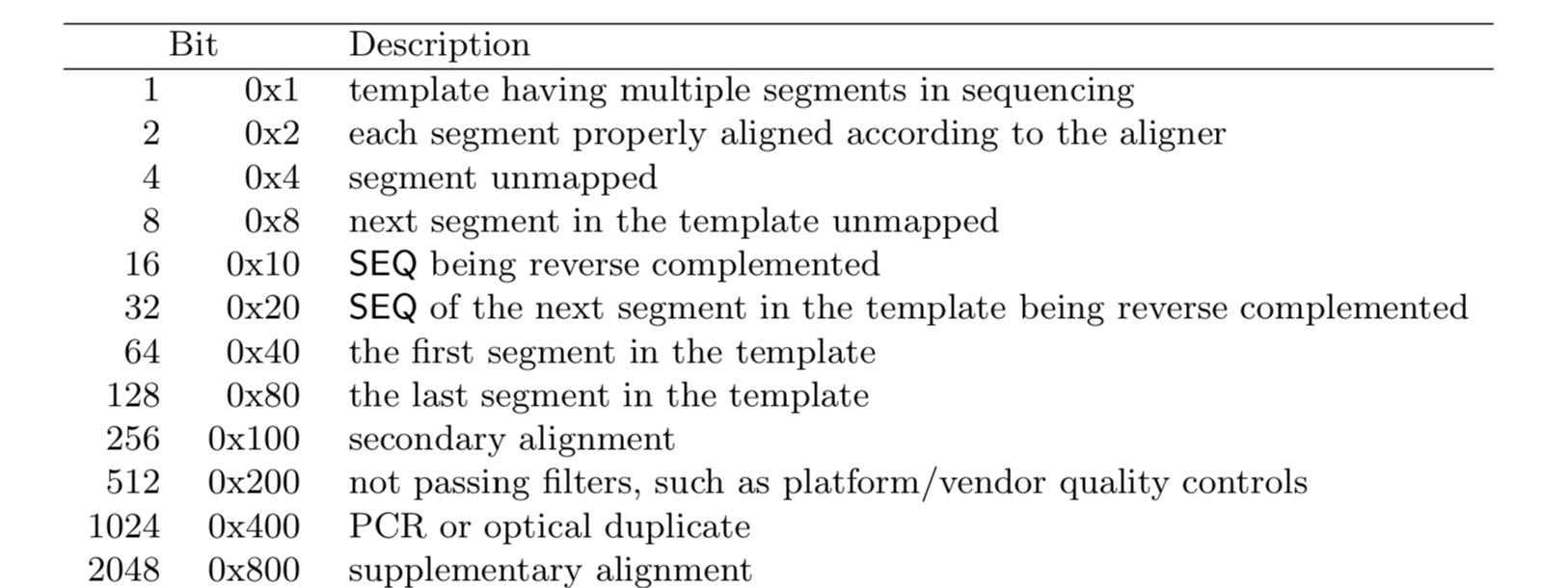
SAM/BAM format
FLAG
CIGAR

Slide 48
SAM/BAM tools
Commandline
Samtools
view
Index
Sort
Picard
MarkDuplicates
Python
Pysam – maintained and developed by CGAT (Andreas Hager)

Slide 49
Illumina RNA-seq workflows

Slide 50
RNA-seq workflow for DEG
Workflow 1:
Hisat2 (align with any spliced mapper) -> featurecounts (counting reads to transcripts) -> DESeq2 or EdgeR (DEG)
Workflow 2:
Kallisto/Salmon -> DESeq2/EdgeR or Sleuth (DEG)
Old workflow:
Tophat2 (align) -> cufflinks (transcript assembly) -> cuffdiff (DEG) -> cuffmerge (merge assemblies)
Hisat2 alignment
Salmon/kallisto
featurecounts
DESeq2
DESeq2/Sleuth
General linear model that accounts for negative binomial distribution

